Slide 1
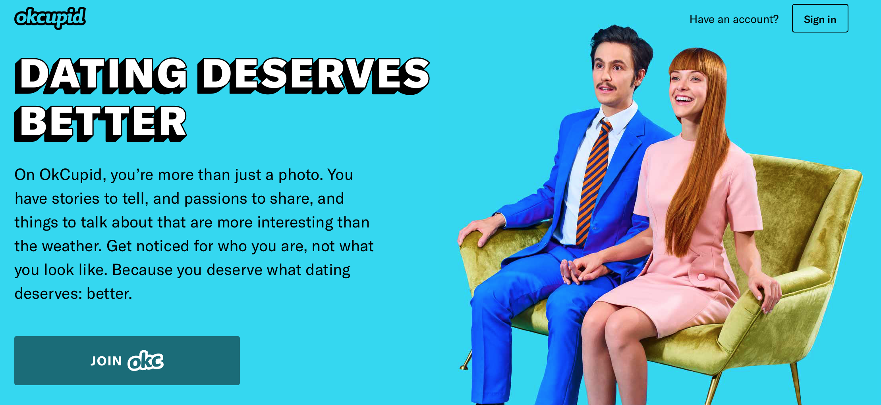
Date-A-Scientist
Machine Learning Fundamentals Capstone
Submitted by: Mark Filipek

Slide 2
Objective
In examining the questions OkCupid users were asked to answer, most appeared to be relatively gender-neutral. Age, education, whether a person smokes/drinks/does drugs, etc…most seemed to be seeking general compatability, regardless of gender.
I sought to determine whether, by using the techniques we have learned, the data could be used to accurately predict the most fundamental thing most users would be seeking in a mate: their gender.

Slide 3
Approach
While several other features of the dataset might give clues to a user’s gender (height, for example), for fun I opted to focus on the dataset features for which the responses may perhaps fall along stereotypically male or female lines:
Diet preferences
Pet preferences
Self-described body type
Length of the combined short-answer responses

Slide 4
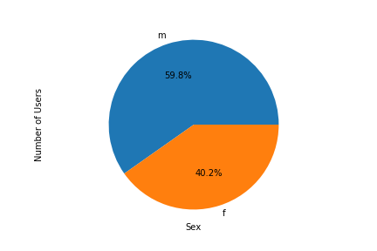
Exploring the Data
First, I wanted to see the proportion of male/female users in our respondent file: 60% male, 40% female

Slide 5
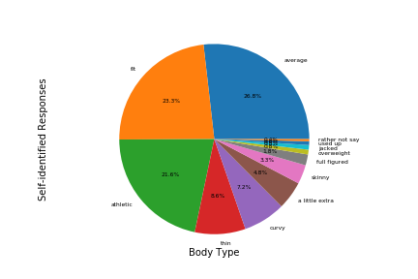
I was also interested in responses to body type, as this is a classically mis-reported descriptor on dating sites: Wow…nearly half say they’re fit or athletic! With another quarter self-reporting as average and very few admitting they have excess weight, this would imply that OkCupid users do not look like the general population. Hmmm….

Slide 6
Augmenting the Data
Because most of the responses were non-numeric, I added 5 columns to the main DataFrame :
Sex_num (male or female)
Pet_num (From most exclusively dog-loving to most cat-loving)
Body_num (from least to most fit)
Diet_num (ordered by dietary restrictions)
Essay_len (total character count of all essay responses)
Each column is a numeric representation of the data
For the Pet/Body/Diet columns, I mapped numeric values that attempted to order the responses along a meaningful scale, as noted above.

Slide 7
Further Visualizing the Data:
With new columns added to the DataFrame, I became interested in the distribution of responses to the questions of Pets, Diet, and Body Type by gender and decided to plot those on histograms to visualize
I wanted to make sure the data wasn’t so clumped that using one of these features would be effectively meaningless
To do this, I created smaller DataFrames for each feature that I broke down along gender lines, finally removing NaN rows
Finally, I plotted both raw and normed data for each, which you will find in the next 3 slides:

Slide 8
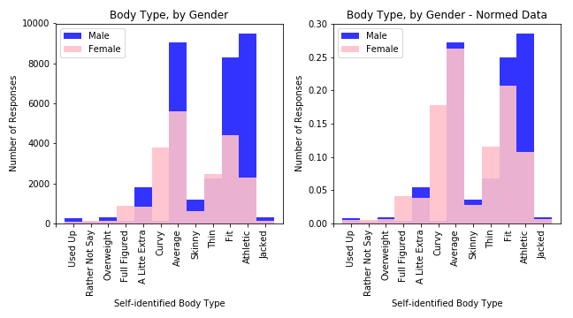
Body Type, by Gender
Not surprisingly, the sexes diverge on descriptions like “Curvy” and “Full-figured” –but also “Athletic” and “Thin” – which validates this feature for classification

Slide 9
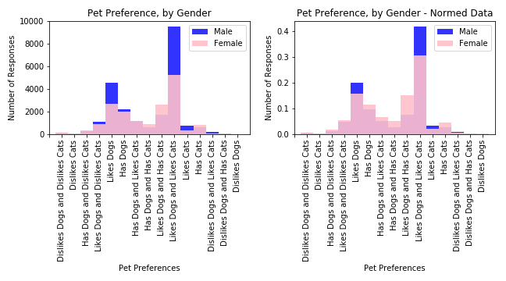
Pet Preference, by Gender
Who doesn’t love dogs? Apparently, not many OkCupid users. Overall, men were more likely to like both dogs and cats, while women tended to have greater incidence of cat ownership.

Slide 10
Diet Type, by Gender
Most OkCupid users reported being pretty easygoing in their food preferences, with slightly higher proportions of women self-reporting as vegetarian and vegan

Slide 11
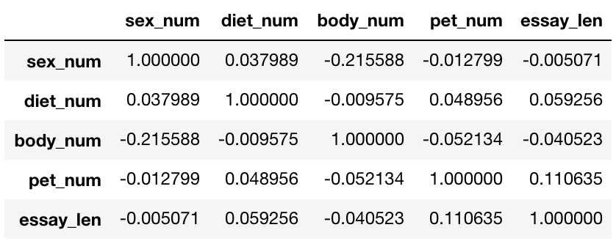
Cleaning the Data
With what I believed to be valid features for predicting a user’s sex, I created a DataFrame of just those features, which I cleaned by removing NaN data. For fun, I ran the correlations amongst these features on the cleaned data:

Slide 12
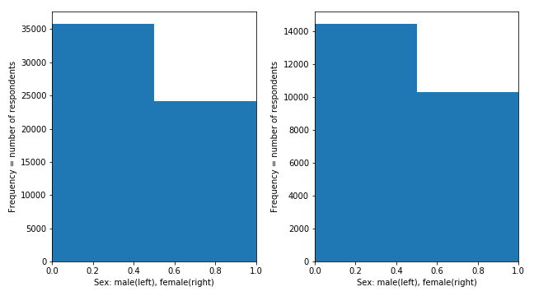
Final Examination of Data
I also wanted to make sure that cleaning the data didn’t materially change the proportion of male/female users, so I plotted two final histograms of the pre- and post-cleaned data. All looks okay:

Slide 13
Data Preparation
Having validated each of the selected features as valuable and ensuring that the cleaned data left the rough proportions of male-to-female users intact, I took the final two steps before running machine learning techniques:
I normalized the cleaned data with MinMaxScaler
I split the Pet/Body Type/Diet Essay Length data into training and test data sets, and used Sex as my training and test labels, by using Train_Test_Split

Slide 14
Classification Techniques: KNN
First, I ran the data sets through a K-Nearest Neighbors Classifier, with the following results:
n=2 n=10
Accuracy: .66182 .68908
Recall: .37506 .44659
Precision: .67012 .70053
F1 Score: .48094 .54545
Note: Since a random guess at binary gender classification (male/female) should be correct 50% of the time, the KNN Classifier outperformed random with statistically significant Accuracy and Precision scores, which are meaningful measures for this purpose

Slide 15
Classification Techniques: SVM
Next, I ran the data sets through a Support Vector Machine using a radial bias kernel, with the following results:
Accuracy: .60105
Recall: .15756
Precision: .58318
F1 Score: .24810
Note: The SVM classification technique still outperforms a random guess

Slide 16
Classification Techniques: Multinomial Naive Bayes
Next, I ran the data sets through a MultinomialNB classifier, which predicted gender with .58227 Accuracy
When I called the .predict_proba() method on the classifier, each data point was predicted with a roughly 60% probability of being a specific gender

Slide 17
Regression Techniques:
Lastly, I ran regression models on the data, with the following .score results:
Multiple Linear Regression:
Score = .05463
K-Nearest Neighbors Regression:
Score = -.17537
(used “uniform” vs. “distance” weighing)

Slide 18
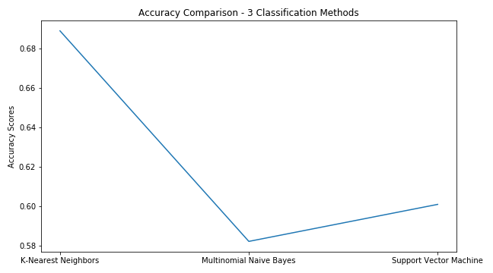
Results Comparison
Clearly, the K-Nearest Neighbors Classifier outperformed the others

Slide 19
Summary
Based upon the accuracy of the various models, I believe that the combination of a user’s responses to questions about Body Type, Pet Preferences, and Diet Choices, combined with the total length of responses to their short-answer-format questions can be used to fairly accurately predict whether that user is male or female.
In evaluating the various models, the K-Nearest Neighbors Classifier performed all others, with the highest accuracy.
Further, the KNN Classifier seemed more nimble than its closest competitor, the Support Vector Machine, which also had significantly better than random accuracy, but which took much longer to run – something that could be a major drawback on a larger dataset.
As a next step, the dataset could be expanded to include a broader cross-section of users. Since this dataset was pulled from a coastal metropolitan area – San Francisco – perhaps add in users from inland or Midwest areas to get a more balanced view of user preferences, though I’m sure if that would improve or hurt the model.
To improve classification accuracy, other features within the DataFrame could be added to the classifier’s dataset – perhaps there is a hidden, “directional” gem within the data. If not, additional questions could be added to the user profiles with the target of building accuracy – from the more obvious and stereotypical (movie genre preferences) to the less obvious but statistically gender-correlated (reading preferences) to the hidden (reading comprehension).

Slide 20
Final Thoughts
Incomplete profiles are clearly an issue for OkCupid. To remove all users with NaN responses from the original database reduces the users from around 60,000 to a mere 4,400. Either there are questions their users are hesitant to answer (like “Offspring” with the fewest responses) or the options they are given as responses are not representative enough (as with “Diet”, which also had a low response rate).
While I also ran the cleaned and normalized data through the various machine learning techniques in other combinations (removing Diet, Pet, Body Type, Essay Length), none achieved better performance than the KNN Classifier built with all four, though removing Essay Length did improve KNN Precision slightly.
To avoid their users being “catfished,” I wouldn’t be surprised to learn that OkCupid has machine learning double-checks in place to validate a user’s true gender – it would be interesting to know what they are using and how accurate their methods are.

